Slide 1

Metasurfaces Design Based on Machine Learning
Jiajun Chen
PHOTONICS INITIATIVE
Mentor: Younes Ra’di, Ph.D.

Slide 2
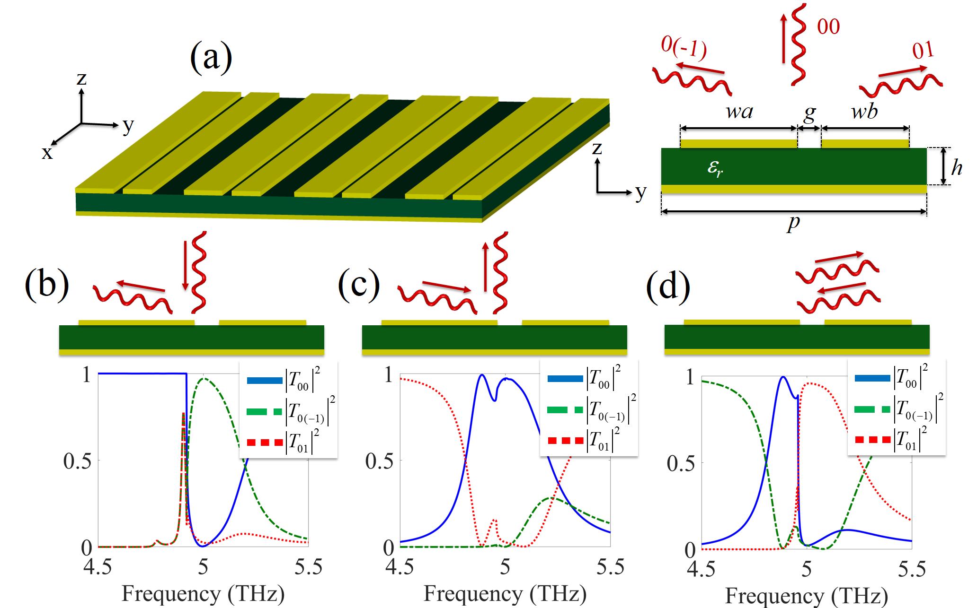
Goal
Design a metasurfaces with required electromagnetic properties

Slide 3
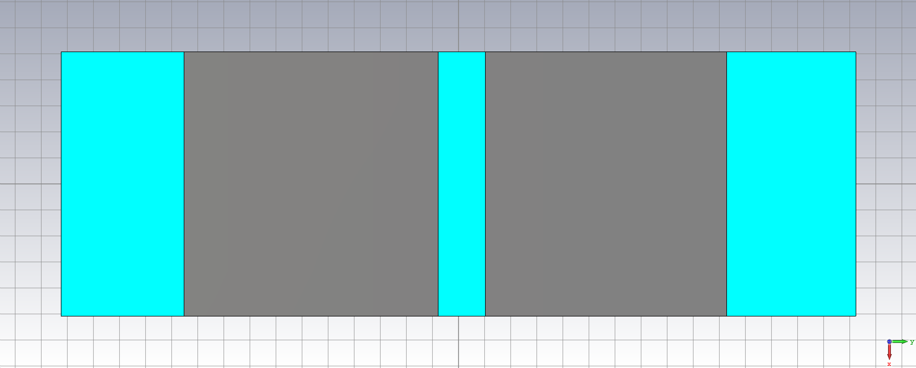
Metal Surface Structure
p=30/sin(tet)
swB
swA
p/6
Shift
Shift
Middle of the strip
y=0
Middle of the strip

Slide 4
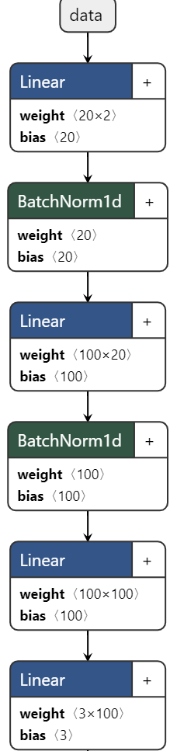
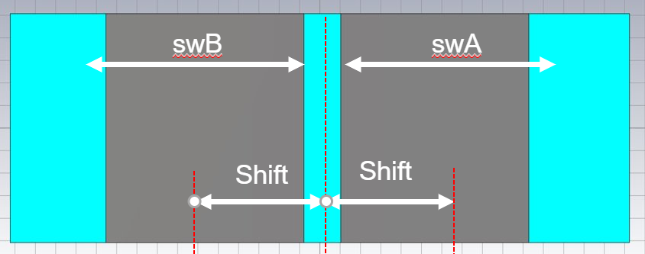
Methods->Machine Learning
[tet Reflectance]
Output: [Shift, swA, swB]

Slide 5
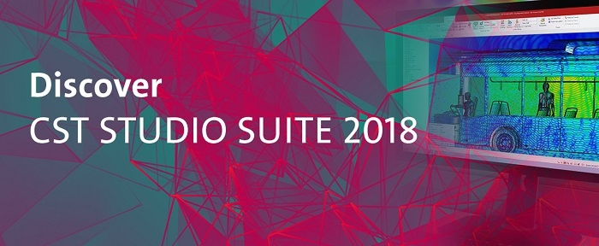
Data -> Current Status of The Project
879 samples as training data
105 samples as validation data.
Time: 14 hours in total
Each sample consists of [Reflectance, tet, Shift, swA, swB]

Slide 6
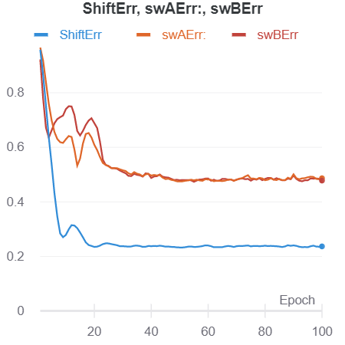
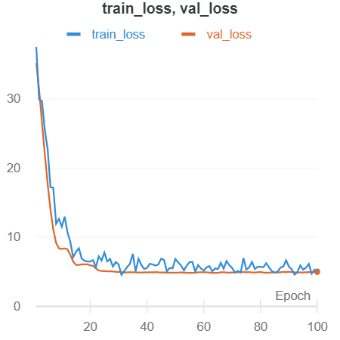
Preliminary results
Percent Error

Slide 7
Demo

Slide 8
Future Goal -> A More Accurate Model
Generate more data(879+105 currently)
Add more parameters into the model
Apply other layers also instead of using Linear layers all the time

Slide 9



?Q&A!
Acknowledgements:
I would like to express my deep gratitude to Professor Ra’di, my research supervisors, for his patient guidance, enthusiastic encouragement, as well as all the staffs that contributes to this wonderful program.

